Slide 1
Bidirectional LSTM in Suggesting Chords
VIP 3601 – Robotic Musicianship 4/4 Presentation
Sabin Kim

Slide 2
Objective
Create a deep learning (Bidirectional LSTM) model that takes in a single line of melody & returns a set of suggested chords (1 chord per measure) to accompany that melody.
IN: .csv file consisting of data about each melody note
Duration (# of semiquaver lengths)
Pitch & Octave
Measure #
Accompanying chord (for training purposes)
OUT: a table of suggested chord per measure

Slide 3
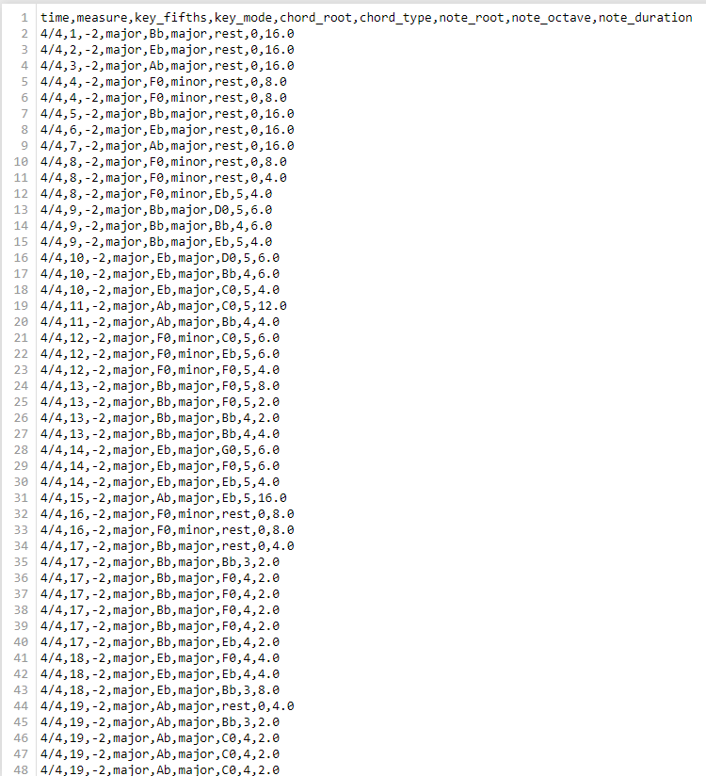
(“Fireflies” – Owl City)
https://arxiv.org/ftp/arxiv/papers/1712/1712.01011.pdf
1,802 training set files
450 test set files

Slide 4
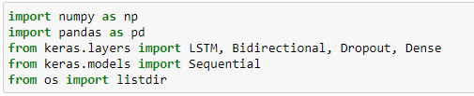
Tools used (note to self: open jupyter rn)

Slide 5
Preprocessing
Map the pitches to an int
‘C0’ : 0, ‘G0’ : 7, ‘G#’ & ‘Ab’ : 8
Map chord types to int [0, 60)
Only 5 types: Major, minor, diminished, augmented, suspended
Transpose all songs to C Major key for consistency
Only 40/1,802 songs were in minor key -> treated them as major songs as well
Timestep = 4; for every sequence of 4 measures:
Melody: size-12 array storing frequency of each pitch in melody
Chords: size-60 one-hot vector: value of 1 on element whose index represents the correct chord

Slide 6
BLSTM Layers
Keras Sequential RNN
LSTM input layer: 12 units
2 hidden BLSTM layers, each with 128 units
Dense output layer: 60 units
20% Dropout layer after each layer
30 epochs, batch size = 512

Slide 7
Results
BLSTM’s output: size-60 vector of floating values [0.0, 1.0]
Assumed index of max element corresponds to model’s suggested chord
Accuracy 47-48%
Overall output: .csv file listing suggested chords per measure for each song
In dataset/csv_test/predictions directory
Failed attempt to generate MIDI file consisting of melody + suggested chords

Slide 8
Thoughts for future works
Programme that converts input MIDI melody into those .csv files
Generating MIDI files for input melody + suggested chords
Maybe repeat this project, but the other way: chords -> melody

